Slide 1
Customer Lifetime Value Prediction Using Machine Learning
Submitted By:
Mahuya Ghosh
Project Type:
Minor Project
Tools Used:
Python | Jupyter Notebook | Machine Learning

Slide 2
INTRODUCTION
Customer Lifetime Value (CLV) is the total revenue a business expects to earn from a customer during their relationship with the company.
Importance of CLV: • Identifies high-value customers • Improves customer retention • Helps optimize marketing expenditure • Supports revenue forecasting • Assists in customer segmentation

Slide 3
PROBLEM STATEMENT
Businesses often have thousands of customers and limited marketing resources.
Problem: How can a business identify which customers are likely to generate the highest revenue in the future?
Solution: Use Machine Learning to predict Customer Lifetime Value based on customer purchasing behavior.

Slide 4
PROJECT OBJECTIVES
The main objectives of this project are:
• Analyze customer transaction data • Calculate customer purchasing metrics • Build a machine learning model • Predict Customer Lifetime Value • Evaluate model performance • Generate business insights

Slide 5
DATASET DESCRIPTION
Dataset Used: Online Retail Dataset
Dataset Features:
• Invoice Number • Stock Code • Product Description • Quantity Purchased • Invoice Date • Unit Price • Customer ID • Country
The dataset contains transaction records of customers from an online retail store.

Slide 6
DATA PREPROCESSING
The following preprocessing steps were performed:
Removed missing Customer IDs
Removed cancelled transactions
Removed negative quantities
Removed negative prices
Created Revenue variable
Revenue = Quantity × Unit Price
Data preprocessing improves data quality and model performance.

Slide 7
FEATURE ENGINEERING
Customer-level features were created:
Frequency = Number of unique purchases
Total Quantity = Total products purchased
Average Order Value = Total Revenue / Frequency
Customer Lifetime Value (CLV) = Total Revenue generated by each customer
These features were used for model training.

Slide 8
MACHINE LEARNING MODEL
Algorithm Used: Random Forest Regression
Why Random Forest?
• High prediction accuracy • Handles nonlinear relationships • Reduces overfitting • Works well on real-world datasets • Provides feature importance information
The model was trained using customer purchasing behavior.

Slide 9
MODEL TRAINING PROCESS
Steps Followed:
Feature Selection
Train-Test Split
Model Training
Prediction
Performance Evaluation
Training Data: 80%
Testing Data: 20%
The model learns patterns from historical customer transactions.

Slide 10
MODEL EVALUATION
Evaluation Metrics Used:
Mean Absolute Error (MAE)
Root Mean Squared Error (RMSE)
R² Score
Results:
MAE = 454.31
RMSE = 5091.47
R² Score = 0.747
Interpretation:
The model explains approximately 75% of the variation in Customer Lifetime Value.

Slide 11
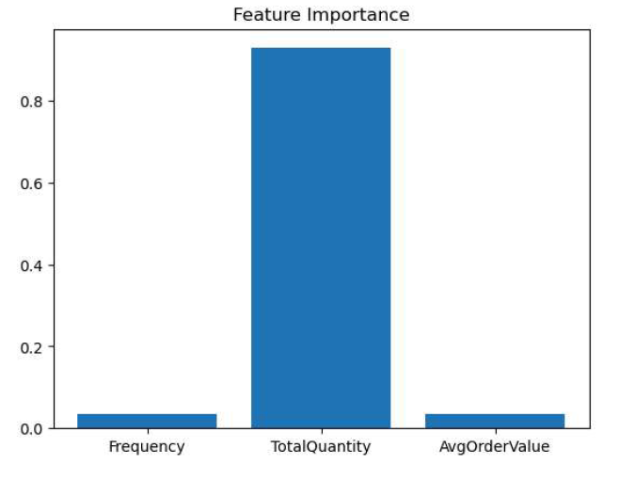
FEATURE IMPORTANCE
The graph shows which
customer characteristics
contribute most to CLV
prediction.
Features with higher
importance have greater
influence on customer value.

Slide 12
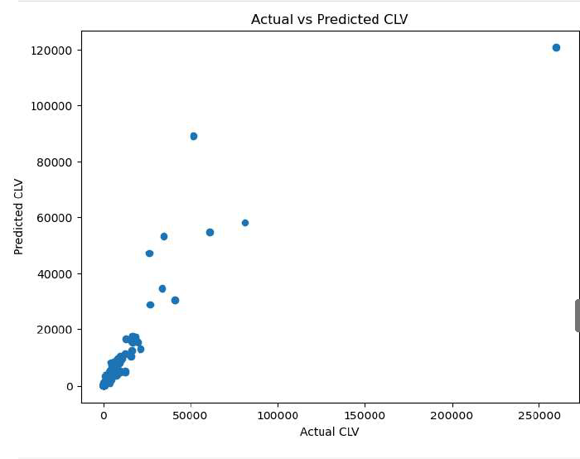
ACTUAL VS PREDICTED VALUES
• Points close to the diagonal
indicate accurate predictions.
• The graph demonstrates
the effectiveness of the
RandomForest model.

Slide 13
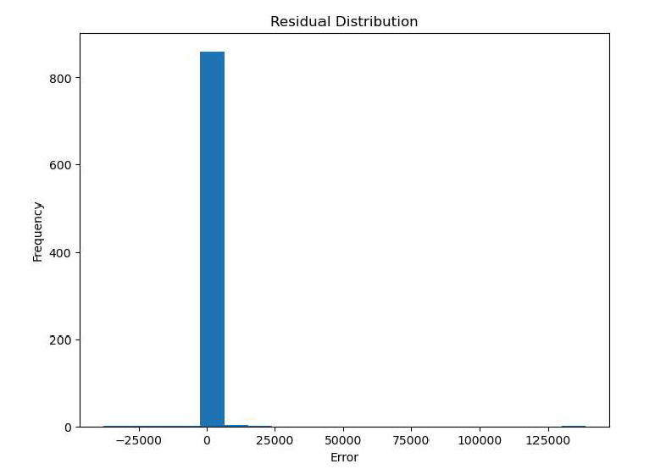
RESIDUAL ANALYSIS
• Residuals represent prediction
errors.
• Most residuals are concentrated
around zero.
• This indicates reasonable model
performance.

Slide 14
BUSINESS INSIGHTS
Key Insights:
• Customers with higher purchase frequency tend to generate greater revenue. • Average order value significantly affects CLV. • High-value customers should be prioritized for retention programs. • CLV prediction helps improve marketing efficiency. • Businesses can forecast future revenue more accurately.

Slide 15
CONCLUSION
• Customer Lifetime Value was successfully predicted using Machine Learning. • Random Forest Regression achieved good predictive performance. • The model can help businesses identify valuable customers. • CLV prediction supports customer retention and marketing decisions. • The project demonstrates the practical application of Machine Learning in business analytics.

